Slide 1
P, NP and NP Complete Problems
Bijay Pathak
08

Slide 2
The Millenium Prize Problems
P versus NP.
Hodge conjecture.
Riemann hypothesis.
Yang–Mills existence and mass gap.
Navier–Stokes existence and smoothness.
Birch and Swinnerton-Dyer conjecture.
Poincaré conjecture
https://en.wikipedia.org/wiki/Millennium_Prize_Problems

Slide 3
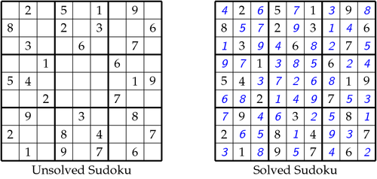
P vs NP problem
It asks whether every problem whose solution can be quickly verified (technically, verified in polynomial time) can also be solved quickly (again, in polynomial time).
Example: Sudoku

Slide 4
P
P is set of problems that can be solved by a deterministic Turing machine in Polynomial time.
Which take time like O(n), O(n^2), O(n^3).... O(n^x).
Example: Multiplication, Sorting, Searching

Slide 5
NP
Non deterministic Polynomial time solving
NP is set of decision problems that can be solved by a Non-deterministic Turing Machine in Polynomial time.
Example: Travelling Salesman Problem, 0-1 Knapsack, Sudoku

Slide 6
NP Complete
Decision problem L is NP-complete if:
1) L is in NP (Any given solution for NP-complete problems can be verified quickly, but there is no efficient known solution).
2) Every problem in NP is reducible to L in polynomial time (Reduction is defined below).
Examples: nxn Sudoku, Protein Folding and many more...

Slide 7
NP hard
Problems that are at least as hard as the hardest problem in NP
Every problem in NP can be reduced to a problem in NP-Hard, in polynomial time.
Thus if we have a polynomial solution to a problem of NP-Hard, we can solve all the NP-problems in polynomial time as well.
Example: Chess, Halting problem

Slide 8
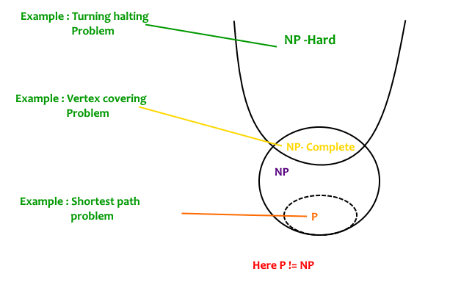
Fig: Types of problems

Slide 9
Is the given problem NP complete?
From the definition of NP-complete, it appears impossible to prove that a problem L is NP-Complete.
By definition, it requires us to that show every problem in NP is polynomial time reducible to L.
The idea is to take a known NP-Complete problem and reduce it to L.
If polynomial time reduction is possible, we can prove that L is NP-Complete by transitivity of reduction (If a NP-Complete problem is reducible to L in polynomial time, then all problems are reducible to L in polynomial time).

Slide 10
References
https://www.geeksforgeeks.org/np-completeness-set-1/
https://www.youtube.com/watch?v=YX40hbAHx3s
https://en.wikipedia.org/wiki/P_versus_NP_problem
http://www.claymath.org/millennium-problems/p-vs-np-problem

Slide 11
Thank you

